Slide 1
Ger’s Garage Website
Balazs Barcza
SB18002

Slide 2
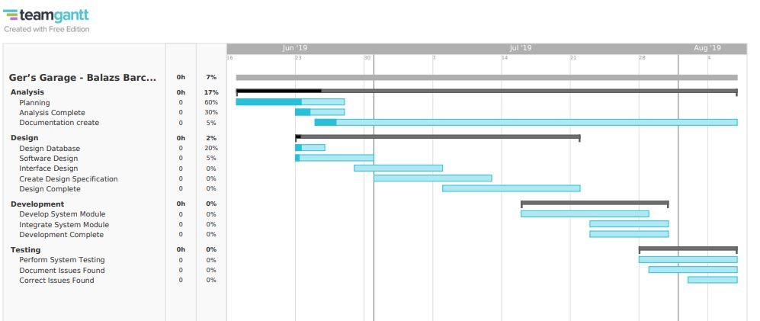
TeamGantt

Slide 3
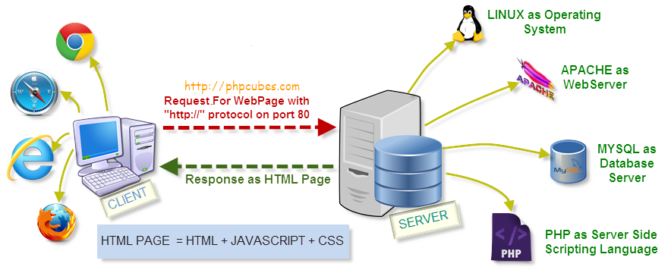
Client-Server

Slide 4
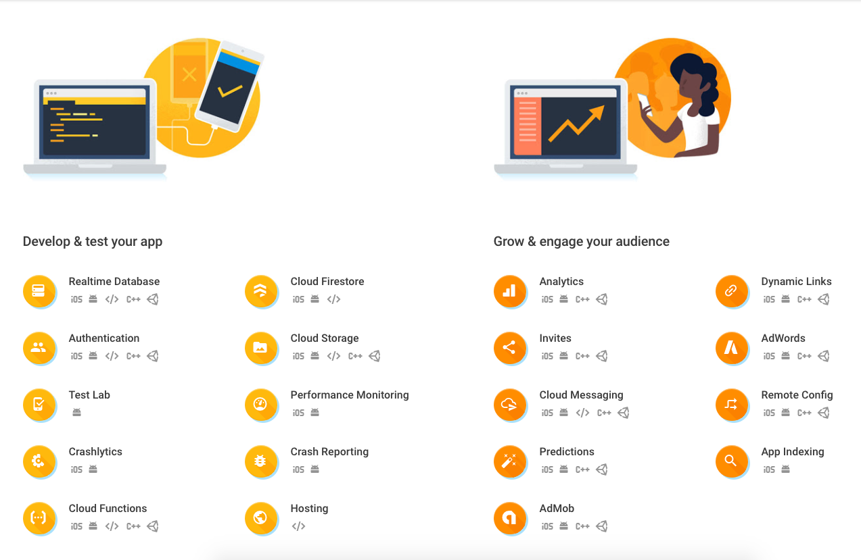
Firebase

Slide 5

Firestore

